Slide 1
Johann Resl
Pulp Dryer Solutions
August 2025
Next Level of Evolution in PD Technology

Slide 2
References past 10 years
17234 | 19-Dec-14 | 13-Mar-15 | International Paper Co. | Saint-Junien Cedex | France | PD 1 | EMEA | Market Pulp
17237 | 18-Feb-15 | 08-May-15 | ENCE Group | Navia | Spain | PD 3 | EMEA | Market Pulp
15844 | 25-Nov-15 | 01-Jan-16 | Stora Enso Oyj | SKUTSKÄR | Sweden | PD 9 | EMEA | Market Pulp
17277 | 21-Dec-15 | 01-Apr-16 | Fibria | Tres Lagoas | Brazil |  | Americas | Market Pulp
17282 | 21-Dec-15 | 01-Apr-16 | Fibria | Tres Lagoas | Brazil |  | Americas | Market Pulp
17304 | 15-Jul-16 | 28-Oct-16 | Stora Enso Oyj | Kotka | Finland | KK 6 | EMEA | Market Pulp
12200 | 24-Oct-16 | 02-May-17 | SCA Graphic Sundsvall AB | Timra | Sweden | PD 6 | EMEA | Market Pulp
15435 | 15-Dec-16 | 05-Jun-17 | Copamex, S.A. de C.V. | San Nicolas De Los Garza | Mexico | MP 2 | Americas | Market Pulp
18129 | 28-Mar-17 | 10-Jul-17 | Stora Enso Oyj | Uimaharju | Finland | PD 2 | EMEA | Market Pulp
18353 | 28-Mar-17 | 28-Feb-18 | Stora Enso Oyj | Uimaharju | Finland | PD 2 | EMEA | Market Pulp
17506 | 26-Mar-18 | 02-Jul-18 | Celulosa Arauco y Constitucion SA | Valdivia | Chile | PD 1 | Americas | Market Pulp
18528 | 20-Jun-18 | 30-Sep-18 | Mondi | Štetí | Czech Republic | PD 1 | EMEA | Market Pulp
18247 | 28-Sep-18 | 21-Jan-19 | Sun Paper Holding Lao Co Ltd | Savannakhet | China | PD 1 | Asia-Pacific | Market Pulp
17710 | 15-Mar-19 | 01-Jun-19 | Nippon Paper Industries Co Ltd | Suita | Japan |  | Asia-Pacific | Market Pulp
19037 | 02-Dec-19 | 27-Mar-20 | Jiangsu Xingguang New Material Technology Co Ltd | Xuzhou | China | PM 6 | Asia-Pacific | Market Pulp
18723 | 22-Feb-20 | 31-Jul-20 | Bracell | Lençois Paulista | Brazil | PD 2A | Americas | Market Pulp
18724 | 22-Feb-20 | 31-Jul-20 | Bracell | Lençois Paulista | Brazil | PD 2B | Americas | Market Pulp
17727 | 14-Apr-20 | 04-Sep-20 | Iwaki Daio Paper | Iwaki | Japan | PD | Asia-Pacific | Market Pulp
18745 | 23-Sep-20 | 15-Jan-21 | Fedrigoni SpA | Fabriano | Italy | PM 6 | EMEA | Market Pulp
19418 | 01-Apr-22 | 05-Jan-23 | Suzano de Papel e Celulose. | Sao Paulo | Brazil | PD 1 | Americas | Market Pulp
19419 | 01-Apr-22 | 05-Jan-23 | Suzano de Papel e Celulose. | Sao Paulo | Brazil | PD 2 | Americas | Market Pulp
19441 | 02-Feb-23 | 30-Aug-23 | Andritz China Ltd | Fo Shan | China | Line 4 | Asia-Pacific | Pulp
19442 | 02-Feb-23 | 31-Aug-23 | Andritz China Ltd | Fo Shan | China | Line 3 | Asia-Pacific | Pulp
19733 | 03-Feb-23 | 03-Aug-23 | Liansheng Pulp & Paper (Zhangzhou) Co., Ltd. | Zhangzhou | China | PD 1 | Asia-Pacific | Pulp
19734 | 03-Feb-23 | 03-Aug-23 | Liansheng Pulp & Paper (Zhangzhou) Co., Ltd. | Zhangzhou | China | PD 2 | Asia-Pacific | Pulp
19973 | 18-Oct-24 | 28-Mar-25 | Shandong Kaixin Heavy Machinery Co., LTD | Weifang | China | PD 2 | Asia-Pacific | Market Pulp
8508 | 25-Oct-24 | 27-Jul-25 | Borregaard AS | Sarpsborg | Norway | PD | EMEA | Market Pulp

Slide 3

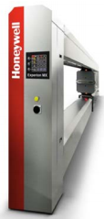
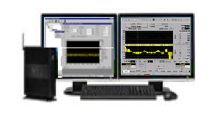



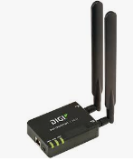

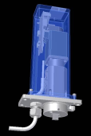
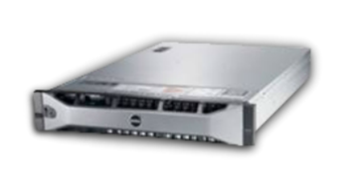

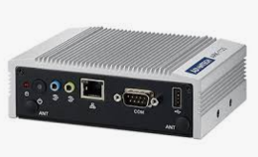

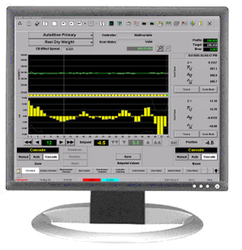
Experion MX Overview
Blower, Filter
Sr90 BW, Z Sensor, MW Moisture, Color Sheet Temp,
Sentience
Cloud Historian
Thin Client Station
Mill Water Supply
AMQP – Advanced Message Queuing Protocol
Secured Data
Switching Hub
4G Routerport
ExperionMX Server Engineering Station
OPC-DA
Outbound
traffic ONLY
ProFlow 55+1
CD-Controls
Steam Box 33+1
CD-Controls
DCS
Edge Device
Embedded PC
Inbound
traffic ONLY
MD Dilution Control
BW, Dry Stock, Moi, Dryer Shutdown, Jet to Wire,
Inner Loops for
MD-Controls
Option

Slide 4
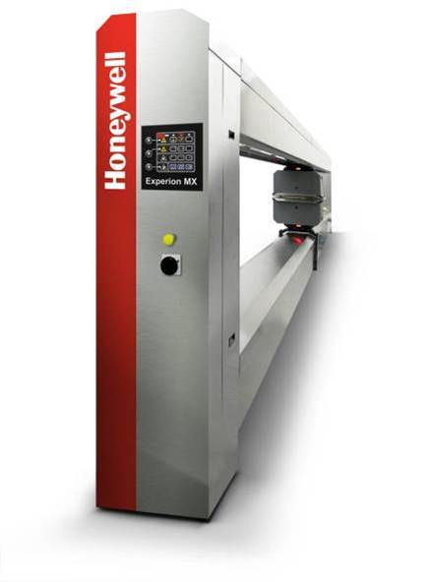
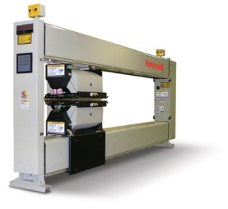
Scanners

Slide 5

Precision Platform 4022 up to 6m Web Width
Fast, Precise Measurement
Compact
Reliable Performance
Easy Maintenance
Notes:
2
To the presenter:
This slide is the “single slide presentation” you might use if asked for a brief overview of the 4022-10 scanner. It can also be used as an overview or outline for this presentation.
Comments:
Scanner is shown in photograph.
Compact
Cost-effective (low cost)
Supports all of Honeywell’s PrecisionPLUS scanning sensors (except Extensional Stiffness)
Provides all PrecisionPLUS measurement features, including
100% Signal Integration
Edge Measurement
Fast Scan for fast profile measurement,
Parallel Profile Processing,
ZOOM High Resolution Profiles,
ZOOM MD Fast MD measurement

Slide 6
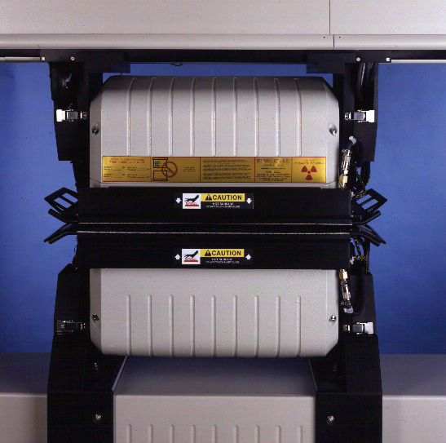
EnviroPak Sensor Enclosure
Accuracy and Reliability Features:
  Air-tight single-plane seals
  Instrument-air purge
  Insulated covers
  Internal air circulation
  Temperature control to ± 1° C
  (± 1.8° F)
Electromagnetic Interference
Protection
Electrostatic Discharge
Protection
Sensor Environment for
Accurate, Reliable Measurement.
Notes:
10

Slide 7
Precision Data Acquisition & Signal Processing
Precision Sensor analogue outputs
“Now” Measurement Zone Profile
16 bit resolution
(15-bits for 0 - 10 volts)
10 volts
Volts
Anti-alias filter
Eng Units / measurement zone
32,768 levels at 10 volts (full signal)
328 levels at 0.1volt (1% of full signal)
4000 samples / sec
Da Vinci Application Server
Volts / sample
-10 volts
Eng Units / Meas. Zone
Database
CD offset from master sensor
Sensor Tc
Sensor spot size
Precision Measurement Processor
Volts
Samples allocation to measurement zones
PrecisionNet
Head position
(100 Hz read rate)
2 - 5 mm
Avg. volts / measurement zone

Slide 8
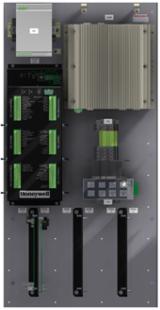
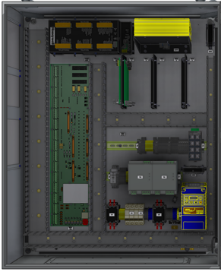
Universal PMP
Next generation scanner interface
  Utilizes Honeywell’s multipurpose Ethernet Data Acquisition I/O board
  which was developed for the Experion MX Q4000-80 scanner
  Avoids commercial computing hardware to extend supportable lifespan
Supports current (except Q4000-80), and most legacy, scanners and
sensors
Drop in replacement for legacy internal and remote PMPs with
obsolete electronics
  Avoids labor intensive, high risk, “box of parts” upgrade
  from ISA to PCI

Slide 9
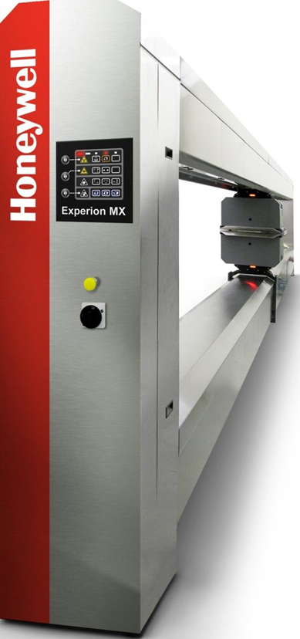
Q4000 Scanner over 6m Web Width
Notes:
2
To the presenter:
This slide is the “single slide presentation” you might use if asked for a brief overview of the 4022-10 scanner. It can also be used as an overview or outline for this presentation.
Comments:
Scanner is shown in photograph.
Compact
Cost-effective (low cost)
Supports all of Honeywell’s PrecisionPLUS scanning sensors (except Extensional Stiffness)
Provides all PrecisionPLUS measurement features, including
100% Signal Integration
Edge Measurement
Fast Scan for fast profile measurement,
Parallel Profile Processing,
ZOOM High Resolution Profiles,
ZOOM MD Fast MD measurement

Slide 10

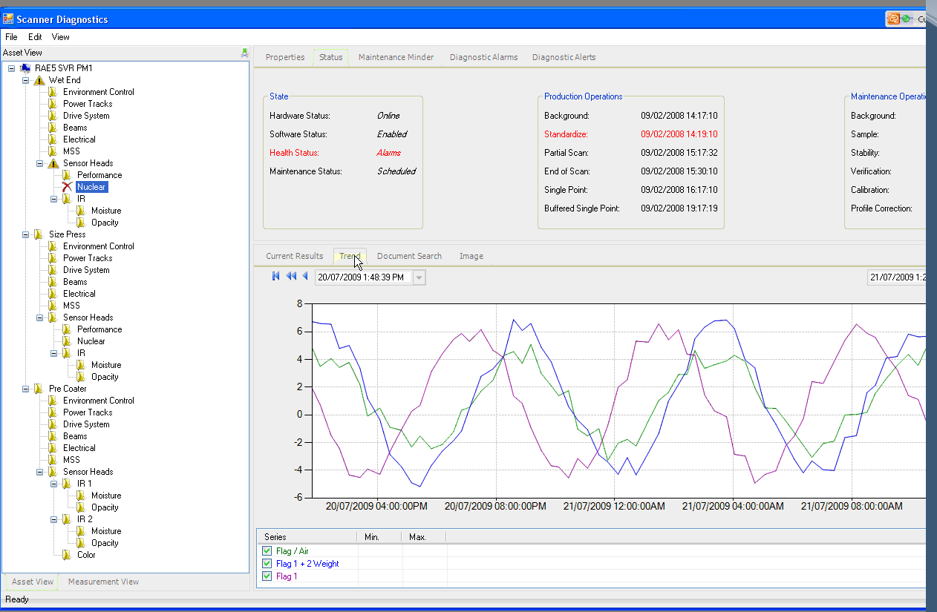
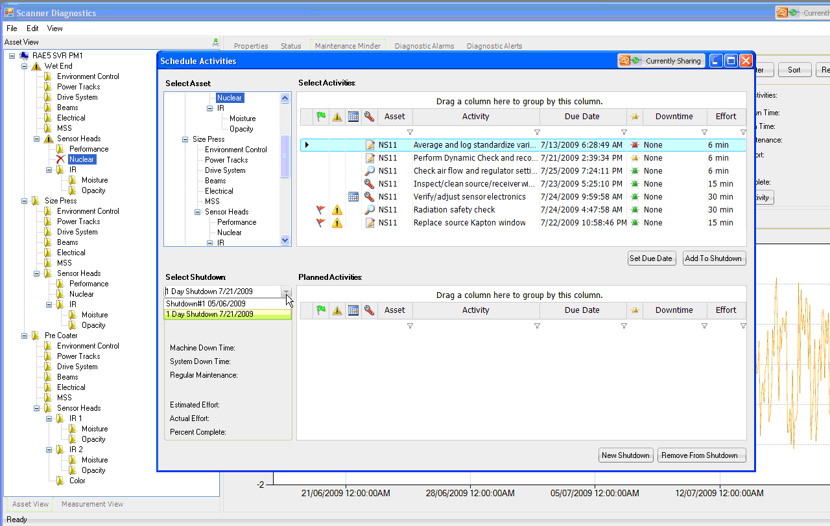
Experion MX – Integrated Measurement System
Enhanced measurements and controls
Improve product quality and
operational efficiency
  Enhanced Profile Measurement
  Unique, New Quality Sensors
  Advanced Multivariable MD and CD Controls
Easy to Maintain to enhance Operational
Reliability and Minimizes Life Cycle Costs
  Modular sensors with
  Embedded Self diagnostics
  simplify maintenance
  Predictive and Preventative
  Maintenance Tools simplify
  troubleshooting
  Intelligent Sensors with
  Digital Signal Processing
  and communication
  provides easy access
  for remote expert support
Notes:
Experion MX has designed to provide the lowest possible life cycle costs and improved measurement reliability. By enhancing sensor self diagnostics and digital communications,
9

Slide 11
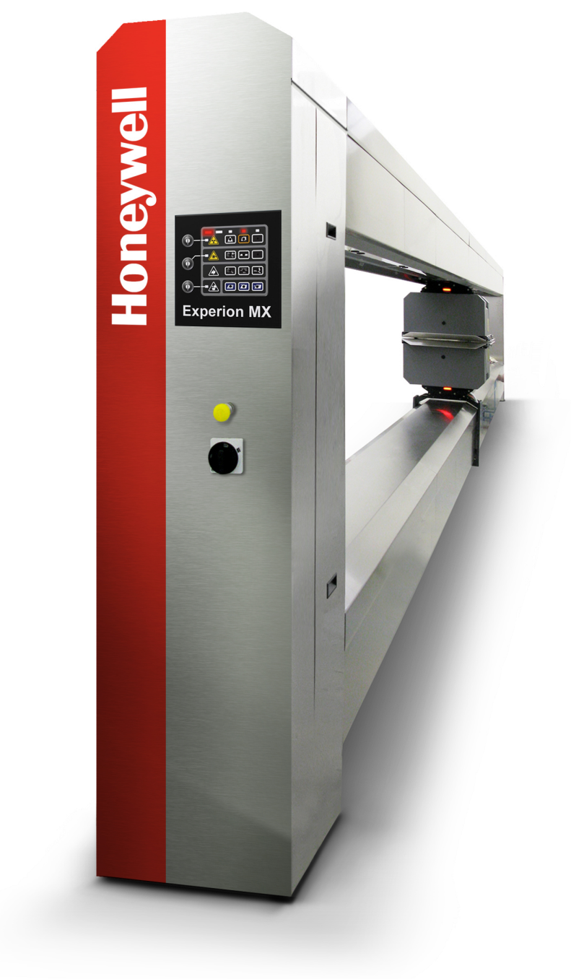
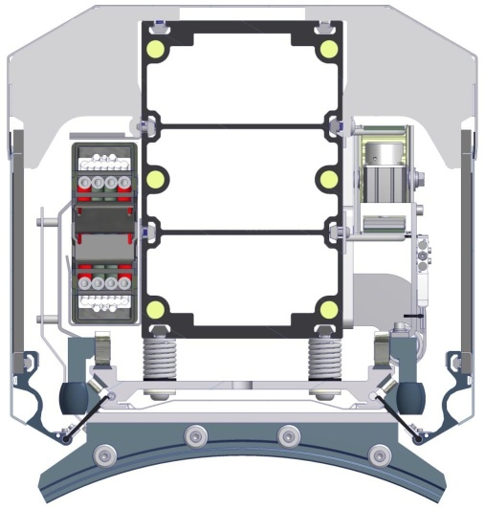
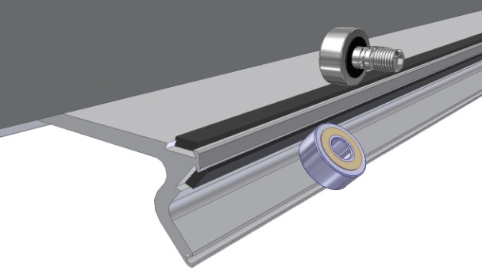
Experion MX – Profile Accuracy
Enhanced Profile Measurement Response
  4000 Hz signal processing with 16 bit resolution
  1200 mm/sec scan rate with 2 mm resolution
    40-67% faster Profile measurement response vs. 600 mm/sec rate
    Improved Edge measurement
Profile Measurement Stability and Reliability
  Patented Thermal Equalization System
    Profile accuracy thru start-ups and break recoveries
  Integral Head accelerometers and dynamic X,Y,Z sensor
    Continuous head alignment verification and predictive alarming
  Improved environmental sealing for reliability
    Stainless steel beam covers with easily removable side panels
  Life-time Head Carriage Rollers
    Polymer Wear Inserts replaceable as needed
  Improved Drive Reliability
Long-Life Power Track
  Silicon coated Wire Package
    Redundant Ethernet
    communication
    Easy access for
    On-line repair and replacement
Notes:
Experion MX has designed to provide the lowest possible life cycle costs and improved measurement reliability. By enhancing sensor self diagnostics and digital communications,
10

Slide 12
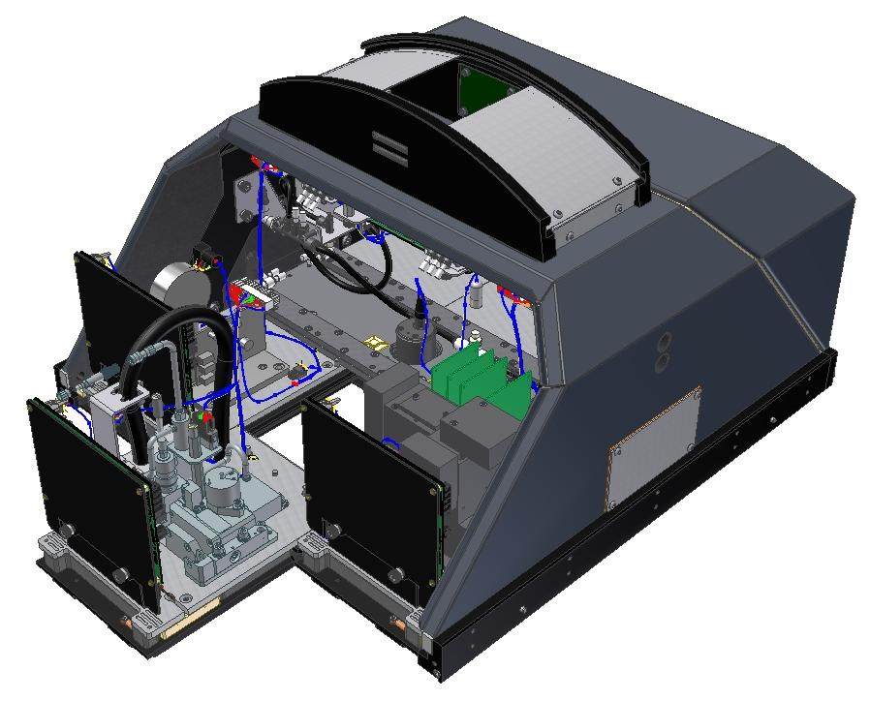
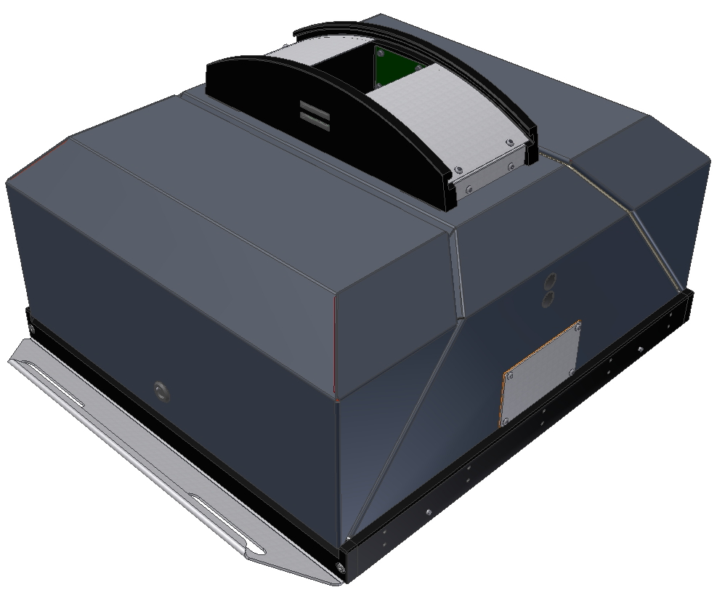
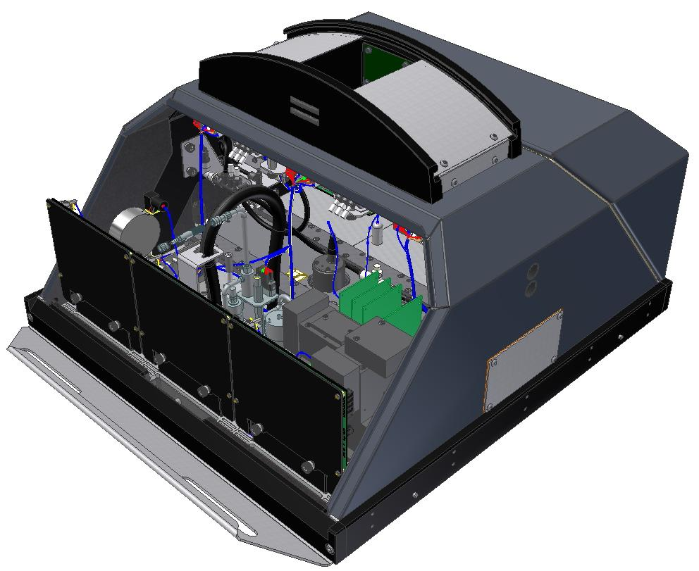
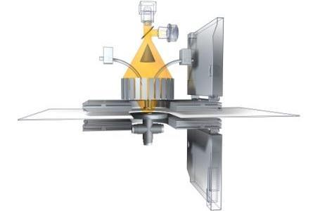
Experion MX – Minimizing Life Cycle Costs
New Modular, Intelligent sensor design
  Improved Sensor / Scanner Self-diagnostics
  Reliable Digital power track
  and remote sensor diagnostic access
  Fast, simple, cost-effective
  sensor replacement and repair
Each sensor module is equipped
with an Ethernet Diagnostic &
Data Acquisition Node (EDAQ)
that connects via standard Ethernet
  Node provides diagnostic web pages
  for service personnel
Sensor modules easily slide on via
mounting rails to connect to power,
cooling, air & communication
  Enables fast removal and replacement
  of sensor modules to reduce downtime
  Built-in Remote access and tools
  to speed expert support
  and system optimization
  No water connections to leak
Notes:
Experion MX has designed to provide the lowest possible life cycle costs and improved measurement reliability. By enhancing sensor self diagnostics and digital communications,
11

Slide 13
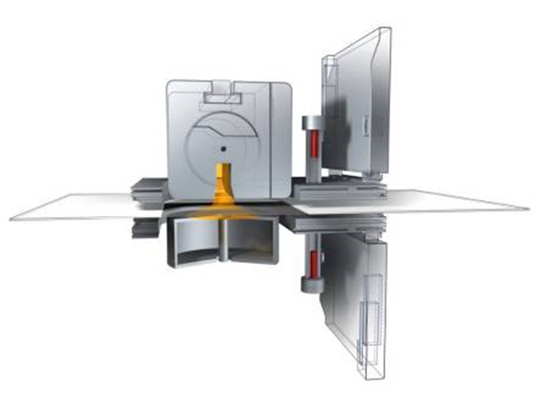
Sensors
Sr90 BW Sensor
Notes:
Tissue-Overview_v6_090310.pptPower Exec Overview_v2_030310.ppt
8/26/2025
12
Tissue-Overview_v6_090310.pptPower Exec Overview_v2_030310.ppt
8/26/2025

Slide 14
Basis Weight Sensor Introduction
Beta-particle absorption principle
Designed with high flux geometry (HFG) principles, for best measurement response
Full Range Standardization modifies sensor calibration across the complete operating range
Other features to maximize performance
Backed by strong application expertise, and flexible options with the NEW Experion MX QCS
*Model Q4202-50
*Model Q4202-50
Notes:
Basis Weight sensors are designed with a few principles in mind.
(1st bullet) All sensors use beta-particle absorption (not said here is that the selection choice of which beta-isotope is important, it is an application choice).
(2nd) All BW sensors are designed with HFG and Full Range Standardization. They are fundamental design philosophy (like the Ultimate Driving Machine for BMW) for Honeywell’s BW sensor design.
(3rd and 4th) Standardizations occurs every 20 min (default). Calibration occurs infrequently. This is why one wants to take advantage of incremental modification to the calibration curves and constants with an intelligent standardizing technique.

Slide 15

High Flux Geometry (HFG) Principles
Reduced Source & Receiver Columns Increases Flux 300%
Reduced Air Columns Reduce Air Temperature Change Effects
Application-Matched Sr90 or Krypton85 sources
Air cylinders, no heating from elec. solenoids
Rotating Source
Source capsule
2 internal standards
“Close geometry”
Notes:
HFG basic description – put the beta particles as close to the paper specimen as possible. Make sure detection is also close to the opposite side of the transition.
Kr – Q4201-62,-63,-64 – uses a rotating source body. When open, there is no shutter gap distance.
Pm – Q4202-50 – Pm does not need as thick a body, shutter design is ok. But there is no electrical solenoid to cause self induce heating.

Slide 16
Full-Range Standardization
Background
  Shutter closed
  8 hour intervals
Off-sheet standardize
  Shutter open
  Adjustable interval
  (20 minutes typical)
Internal standard measurement
Repeatability sample check
Corrects for:
  Background radiation
First-order correction for:
  Source decay
  Electronic drift
  Δ air mass
    Δ barometric pressure
    Δ air temperature
    Δ gap height (Z)
  Dirt buildup on windows
Precisely corrects for response shift with dirt buildup
Built-in performance verification
Notes:
In addition to dirt simulation, standardization performs other corrections.

Slide 17
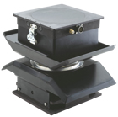
Sensors
Micro Wave Moi Sensor
Notes:
Tissue-Overview_v6_090310.pptPower Exec Overview_v2_030310.ppt
8/26/2025
16
Tissue-Overview_v6_090310.pptPower Exec Overview_v2_030310.ppt
8/26/2025

Slide 18
Principle of Measurement
Dielectric constants
  Water: 80
  Fiber: 3
Web’s dielectric constant is, therefore, greatly affected by the moisture content
Pure Dielectric Constant is measured
  Not absorption or power loss
1000 to 3000 MHz
Cavity resonators are sensing elements
Frequency shift is measured with extreme accuracy
  Not signal amplitude
Measurement and Reference Frequencies utilized

Slide 19
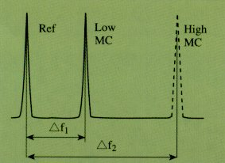
Double Resonance
The frequency difference is a measure of the moisture content
Sharp resonance peaks ensure high precision

Slide 20
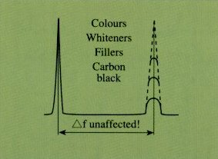
Insensitive to Absorption
Minimum sensitivity to sheet composition
Easy and reliable calibration

Slide 21
Specifications
Measurement Range
Repeatability (2σ)
Accuracy (2σ)
Dynamic Correlation (2σ)
Measurement Spot Size
Related Measurements
2270: 3% 600 gsm H₂O
2273: 3% to 1500 gsm H₂O
±0.1% absolute moisture
±0.25% absolute moisture or 2% of web moist. (if greater)
±0.5% absolute moisture or 3% web moisture (if greater)
10.2 cm (4 inches)
Basis Weight

Slide 22
Features and Benefits
Microwave Frequency Shift Measurement technique
High frequency Microwaves
Non-contacting Design
Dual Resonant Cavity
Automatic Standardization
Dynamic Z, Sheet Temp Sensors
High-resolution Measurement on Heavyweight Products
Unaffected by Salts, ΔpH, ΔCarbon Levels in Sheet
No Contaminant Build-up
Unaffected by Moisture Stratification in the Sheet
Long-Term Measurement Accuracy
Accurate Measurement Under Varying Process Conditions

Slide 23
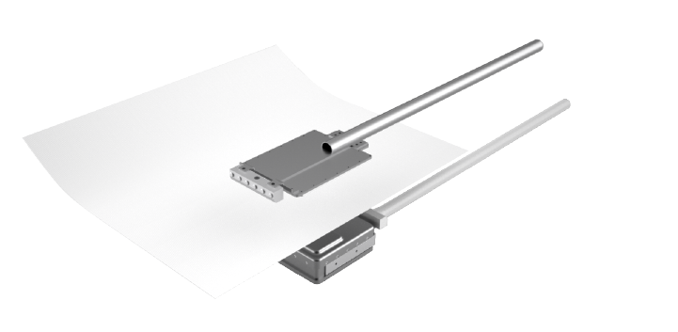
Sensors
Active Microwave Sensors
Micro Wave Moi MD Sensor
Notes:
Tissue-Overview_v6_090310.pptPower Exec Overview_v2_030310.ppt
8/26/2025
22
Tissue-Overview_v6_090310.pptPower Exec Overview_v2_030310.ppt
8/26/2025

Slide 24
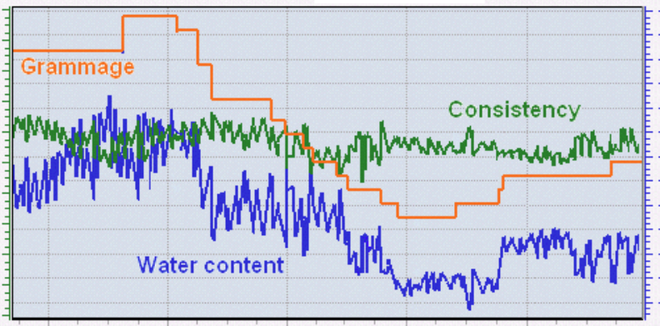
Pre Dryer Moisture MD
The water content at press section is very critical in pulp and paper production process because of his direct influence on the operation of the dryer section with important effects on energy consumption and runnabilty of the machine.
The R1 has superior tolerance to the oscillation/vibration of paper sheet and is completely independent from other sheet properties like color, type of fibers, temperature.
No contact with the sheet is needed and no recalibration needed with grammage production change (virtually maintenance free).
Quality Efficiency Runnability
Notes:
Fixed point sensors can be located at many places along the path of the paper machine, including through the dryer sections. Each Sensor Control Cabinet (SCC) can support six sensors.

Slide 25
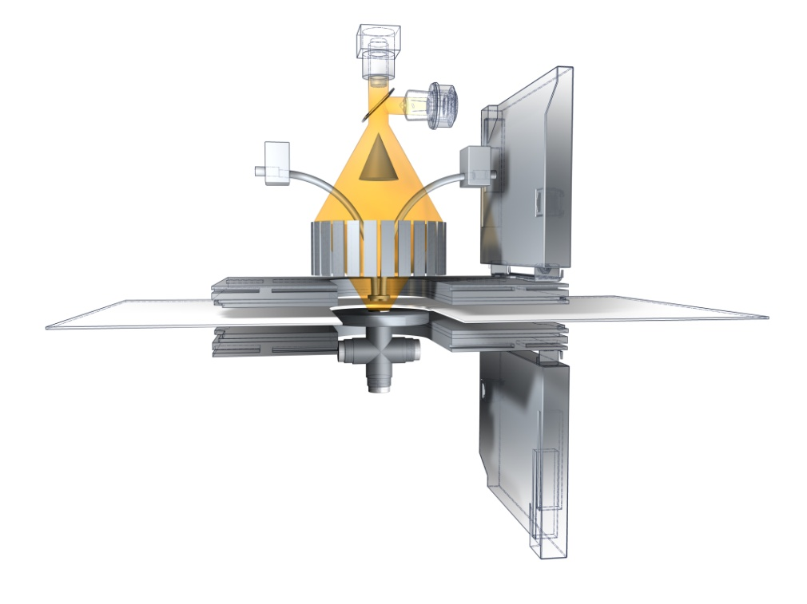
Q4215-61 Color Measurement Introduction
10 Hz response:
  L*, a*, b*, FI, Br, Whiteness
  All measurements corrected to infinite-pad reflectance
Color is calculated from measured reflectance spectrum, giving benefit of metamerism analysis
Moving sheet is stabilized using non-contacting vortex sheet control
The effect of dust and dirt buildup on color measurement is mitigated online
Laboratory accuracy
Notes:
- Introduction slide
Honeywell’s Color Measurement provides scanning measurements of color and appearance quantities of paper web able to provide profiles and trends of the coloring process.

Slide 26

Measured variables
Spectral quantities:
  Reflectance R(λ)
  Apparent reflectance R’(λ|S) for an illuminant S
Derived quantities under defined CIE observer(s) and illuminant(s):
  CIE tristimulus values XYZ
  CIE L*, a*, b* or Hunter L, a, b
  Brightness (ISO,TAPPI, D65)
  Fluorescence index FI
  CIE Whiteness and Tint
As samples of stack or estimated stack measurements on a single layer moving web
R(λ)
Specify:
- CIE illuminant
- CIE observer
CIE
Whiteness
X, Y, Z
x, y, z
CIE
L*, a*, b*
Hunter
L, a, b
L* = 100
+b*
+a*
-a*
-b*
L* = 0
Notes:
From reflectance (UV excluded measurement) and apparent reflectance for an illuminant S (UV included measurement) any other derived color and apparent quantity can be calculated under specified CIE observer and illuminant.
Q4215 provides most used color and appearance measurements.
Color is measured following ISO standards:
ISO 5631-1 indoor daylight conditions C/2
ISO 5631-2 outdoor daylight conditions D65/10
ISO 5631-3 indoor illumination conditions D50/2
Brightness:
ISO 2470-1 Indoor daylight conditions (ISO brightness)
ISO 2470-2 Outdoor daylight conditions (D65 brightness)
CIE Whiteness:
ISO 11475 outdoor daylight conditions D65/10
ISO 11476 indoor daylight conditions C/2
25

Slide 27
Q4215 Color Measurement
10 Hz response:
  L*, a*, b*, FI, Br, Wht
  All measurements corrected to infinite-pad reflectance
Color is calculated from measured reflectance spectrum, giving benefit of metamerism analysis
Moving sheet is stabilized using non-contacting vortex sheet control
The effect of dust and dirt buildup on color measurement is mitigated online
Laboratory accuracy
Notes:
- Introduction slide
Honeywell’s Color Measurement provides scanning measurements of color and appearance quantities of paper web able to provide profiles and trends of the coloring process.

Slide 28
Experion MX SW
Sensor
MD
CD
Color
TMMS
Sensor
MD
CD
Color
TMMS
Processing
Control
Control
Control
Core
Processing
Control
Control
Control
Core
RAE
RAE
Real-Time Application Environment (RAE)
API
Real-Time Application Environment (RAE)
API
Process
Alarm
Process
Recipe
Alarm
. . .
Recipe
. . .
I18N
ODX
OPC
Visibility
I18N
ODX
OPC
Processing
Visibility
Handling
Processing
Handling
Notes:
Updated 2014.04.07by Antti Paavola.

Slide 29
Experion MX Application SW
The Experion MX Application Software provides the basic application packages for Experion MX Quality Control System (QCS). These applicaton packages build the foundation for QCS measurement subsystem, scanner and sensor support, analysis, reporting, information system and seamless integration to Machine Directional (MD) and Cross Directional (CD) Control applications.
Sensor
MD
CD
Color
TMMS
Sensor
MD
CD
Color
TMMS
Processing
Control
Control
Control
Core
Processing
Control
Control
Control
Core
RAE
RAE
Real-Time Application Environment (RAE)
API
Real-Time Application Environment (RAE)
API
Process
Alarm
Process
Recipe
Alarm
. . .
Recipe
. . .
I18N
ODX
OPC
Visibility
I18N
ODX
OPC
Processing
Visibility
Handling
Processing
Handling
Standard Displays | Analysis Displays | MIS Displays
Limit Alert | Histogram | Reel Display
Recipe Change | Trend Plot | Shift and Day Display
Production Data | SQC Charts | Grade Display
Profiles | Streak Detection | Numeric profile
Data Display | Profile Stability | Report Setup
Multiple Profiles | Histogram
High Resolution Profiles | History Trend
Quality Summary | Profile Spectrum
Trend & Profile | MD Spectrum
Multi Fixed Point | Fixed Point Analysis
Trend & Fixed Point
Multi Profile White
Operator Displays
The Da Vinci Application Software package
provides the operator displays which are
common to all QCS configurations:

Slide 30
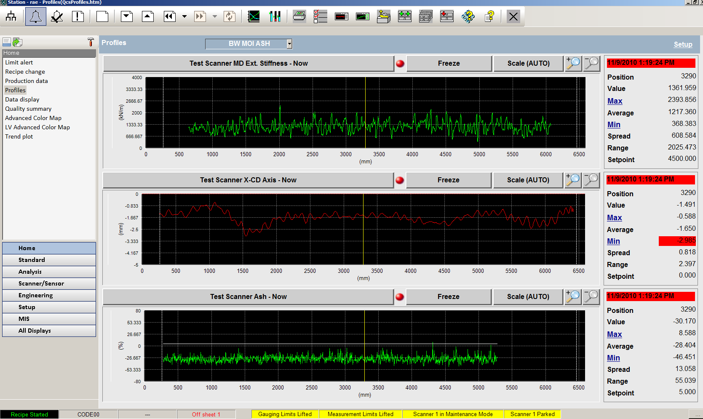
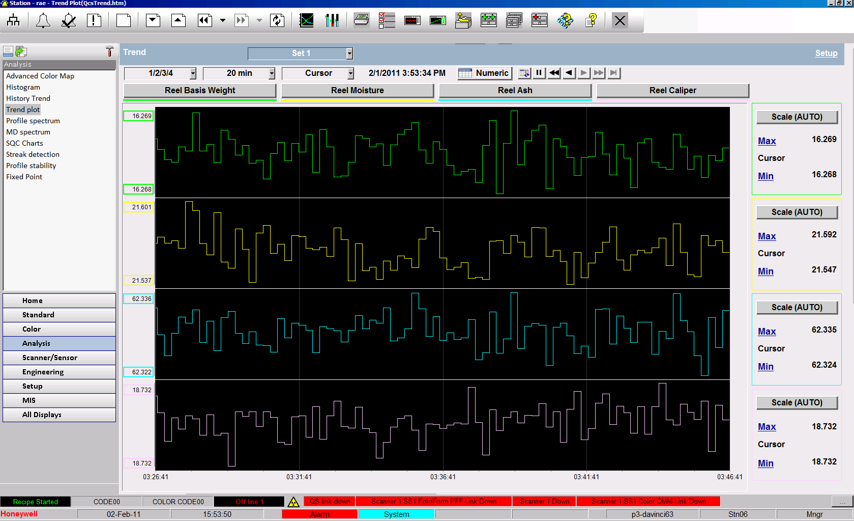
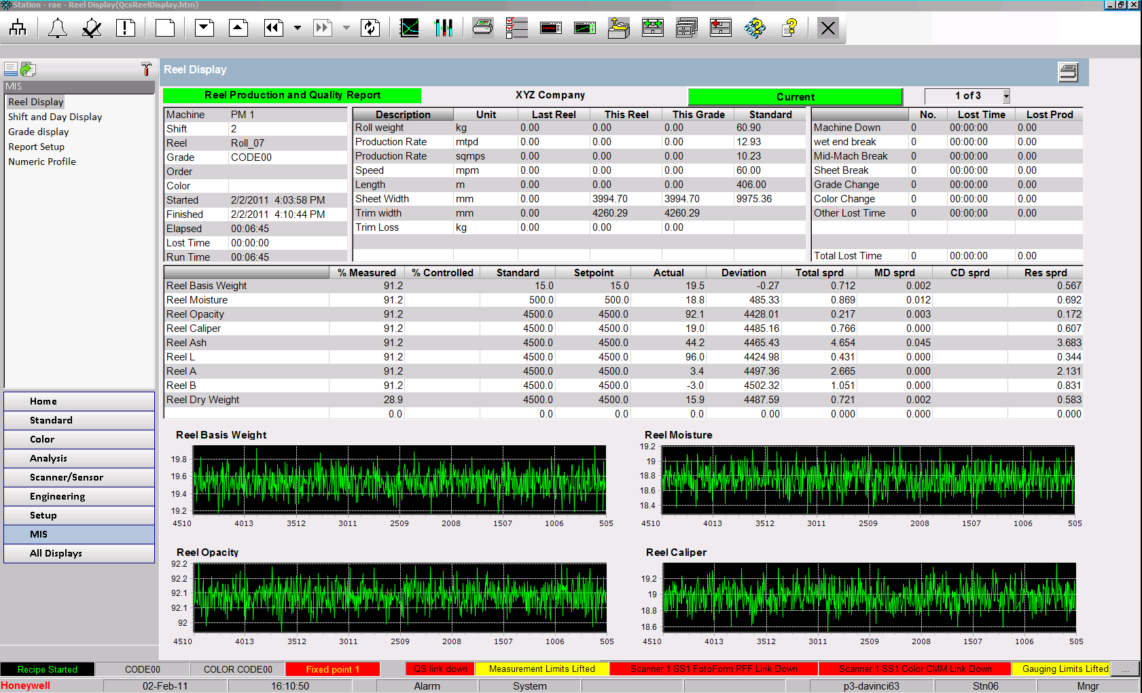
Experion MX Application SW Display Examples
Profile Display
Trend Plot Display
Reel Display

Slide 31
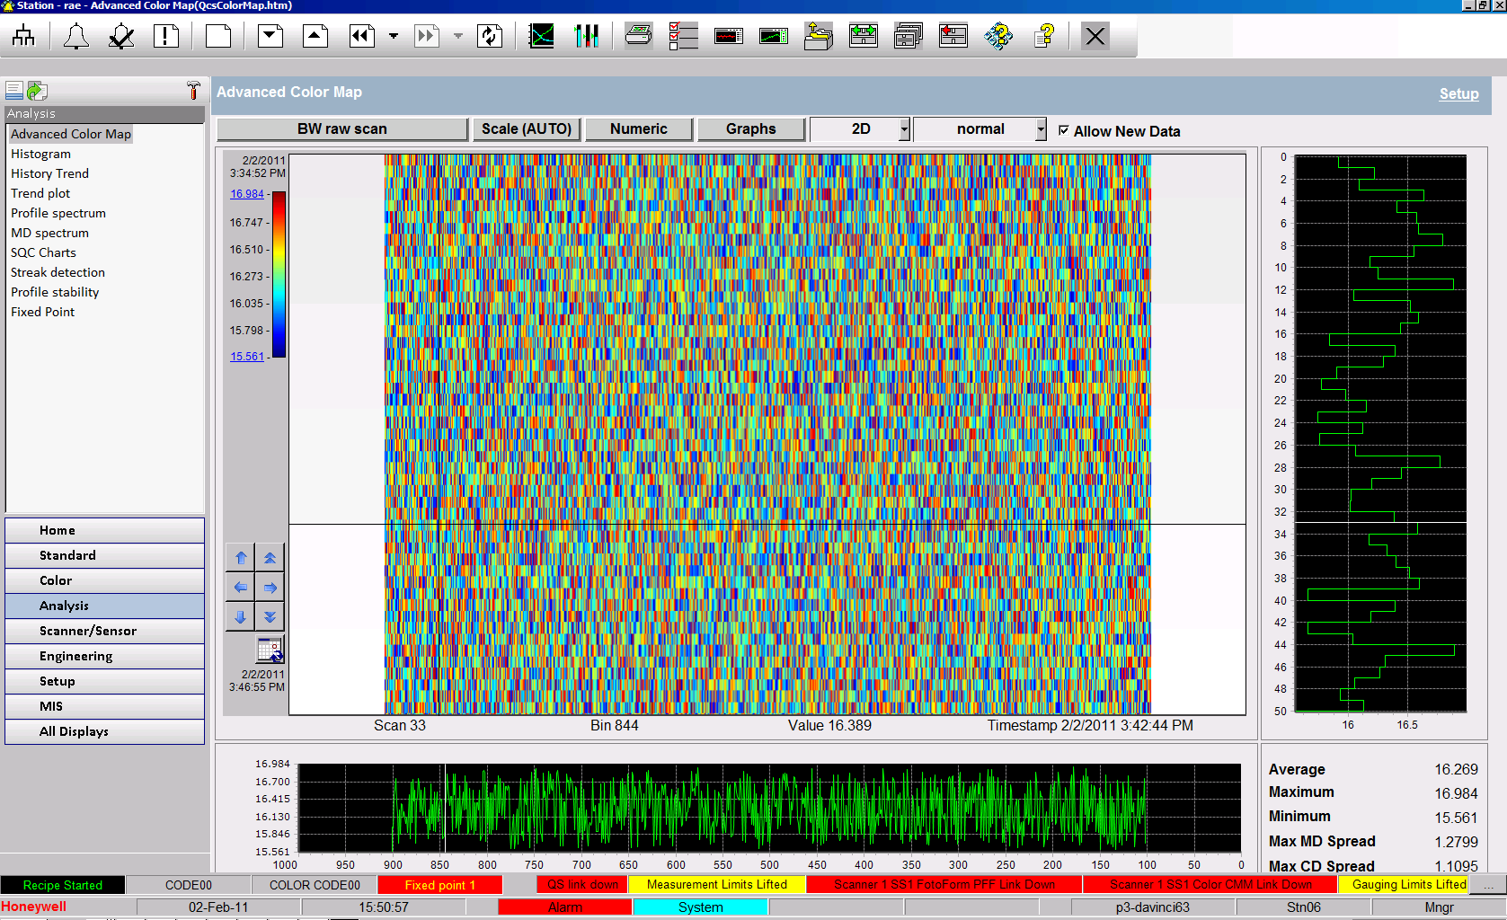
Advanced Color Map
Advanced Color Map
The Advanced Color Map display shows fifty scans of data in either a two or three dimensional plot using colors to indicate the amplitude of the data. Additionally, a MD trend and a CD profile can be viewed for any point within the fifty scans. This display is typically used to analyze a series of profile arrays from scanning sensors, but it can be used to plot any array data in the Experion MX system. The color map format makes it easy to spot trends or patterns in the data.

Slide 32
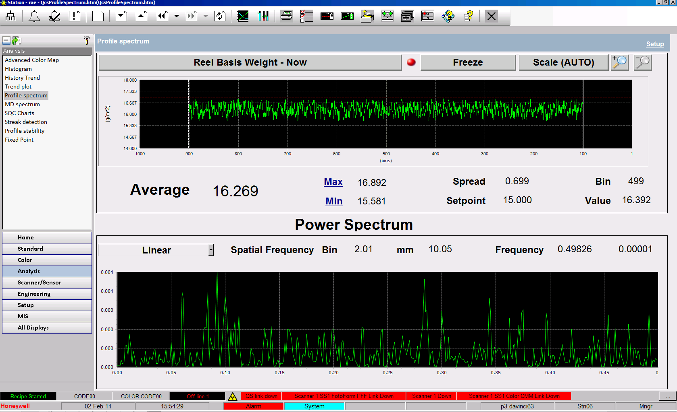
Profile Spectrum
Profile Spectrum
The Profile Spectrum display shows the frequency power spectrum of any cross direction profile measured by a scanning sensor. The power spectrum highlights dominant spatial frequency components as distinct peaks. This is very useful when trying to determine the source of profile variations or when evaluating cross direction control performance.
MD Spectrum
The MD Spectrum Display shows the frequency power spectrum of any trended (i.e. time based) variable in the Experion MX system. The power spectrum highlights dominant frequency components as distinct peaks. This is very useful when trying to determine the source of machine direction variations or when evaluating machine direction control performance.

Slide 33
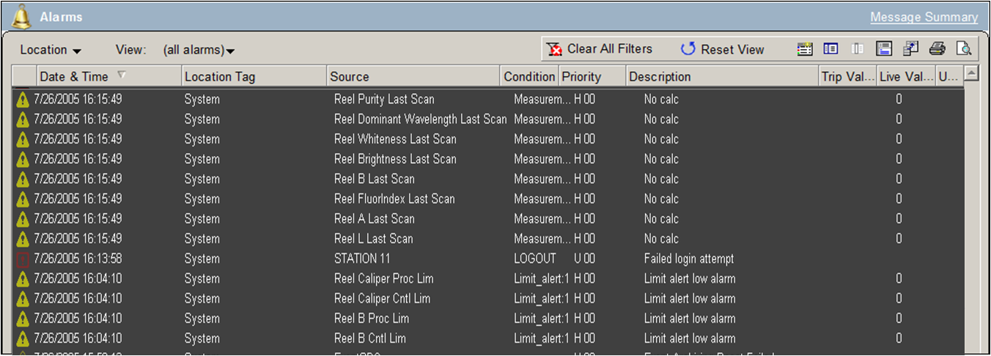
Alarm Handling
Alarm Summary
Process, control and system maintenance alarms are shown on the Alarm Summary display, which has been designed to conform to the Abnormal Situation Management (ASM) Consortium’s recommended guidelines. The Alarm Summary is highly configurable (e.g. custom help text, priority colors, alarm grouping) to ensure that operators are presented with the data they need to focus on the problem at hand. A one line summary (date and time, source, condition, priority, description, etc.) is shown for each alarm as well as an indication of whether or not it has been acknowledged. The Alarm Summary can be quickly accessed by a button on the static toolbar or by clicking on the Alarm Indicator in the status zone. The Indicator turns red when alarms are present and blinks until all alarm conditions are cleared, or the operator acknowledges them.

Slide 34
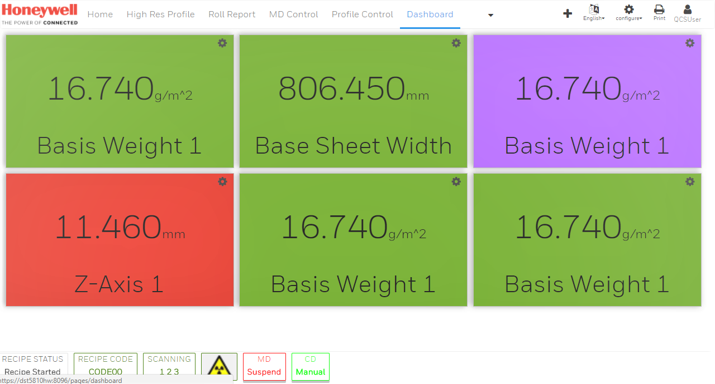
HTML5 Web Displays
Notes:
Updated 2014.04.07by Antti Paavola.

Slide 35
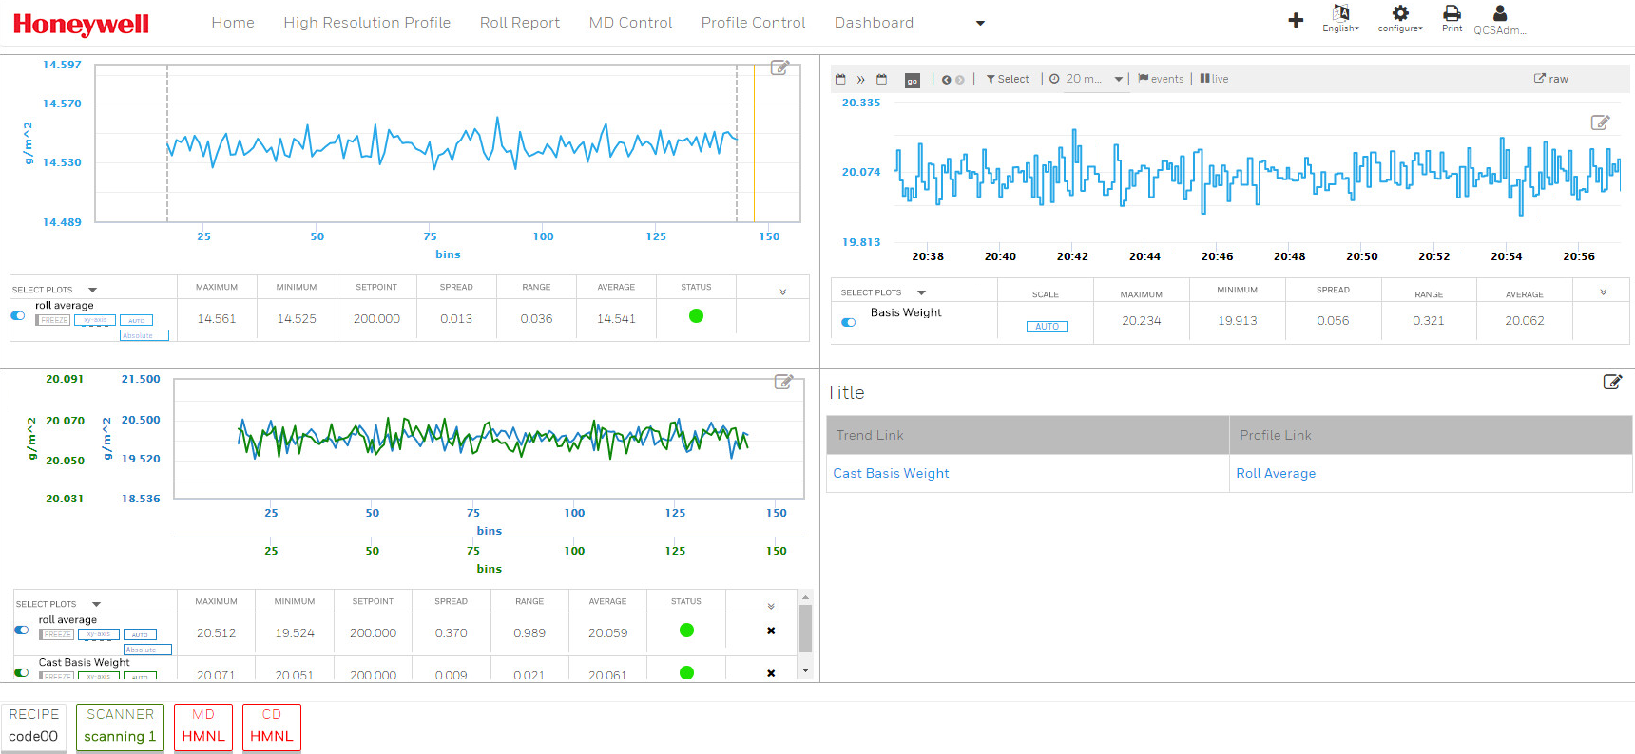
HTML5 Web Displays
Zero Install HMI
  Access displays from Web Browser –Chrome, IE without any installation required on client machines.
Multiple Screen and Device Support
  Auto Scale to big size monitors. (55 inch)
  Supports normal monitors / PC station. Touch / Non-touch Screens.
  Support 11” and above Tablet and Pads.
Support for all Paper and CWS segments.

Slide 36
HTML5: Four Control Template Example

Slide 37
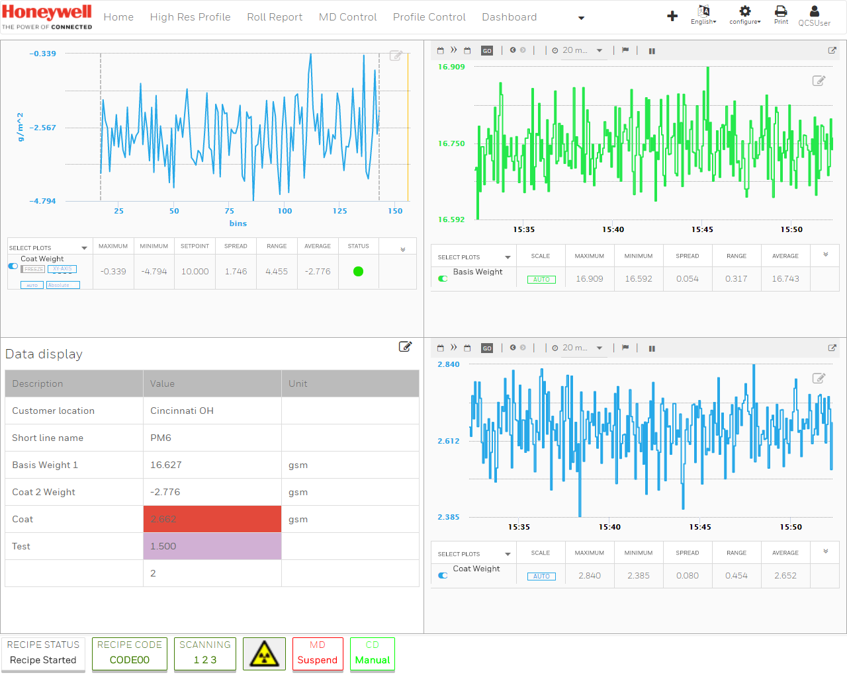
HTML5: Four Control Template Example

Slide 38
Extended History

Slide 39
Extended History
QCS Extended History is
  Simple to Configure
  Integrated with QCS Platform
  Usable for Operators and Engineers
One Year History Supports
  Trend Variables (Scalar Parameters)
  ACM Variable (Array Parameters)
  MIS Reports
It Enables
  Data for engineering and process analysis
  Foundation for quality management system.
EHDB | Total number of Trend Variables (Scalar Values) | 120*
 | Total number of ACM Variables (Array) | 30
 | Total Number of virtual Trends | 120*
 | Minimum Sampling Period in seconds | 5
 | History Support Duration in Year | 1
MIS | Minimum Reel Turn-up Time (In minutes) | 15
 | Total Rolls in a Year | 30,000
* As a special can be extended to support more variables.

Slide 40
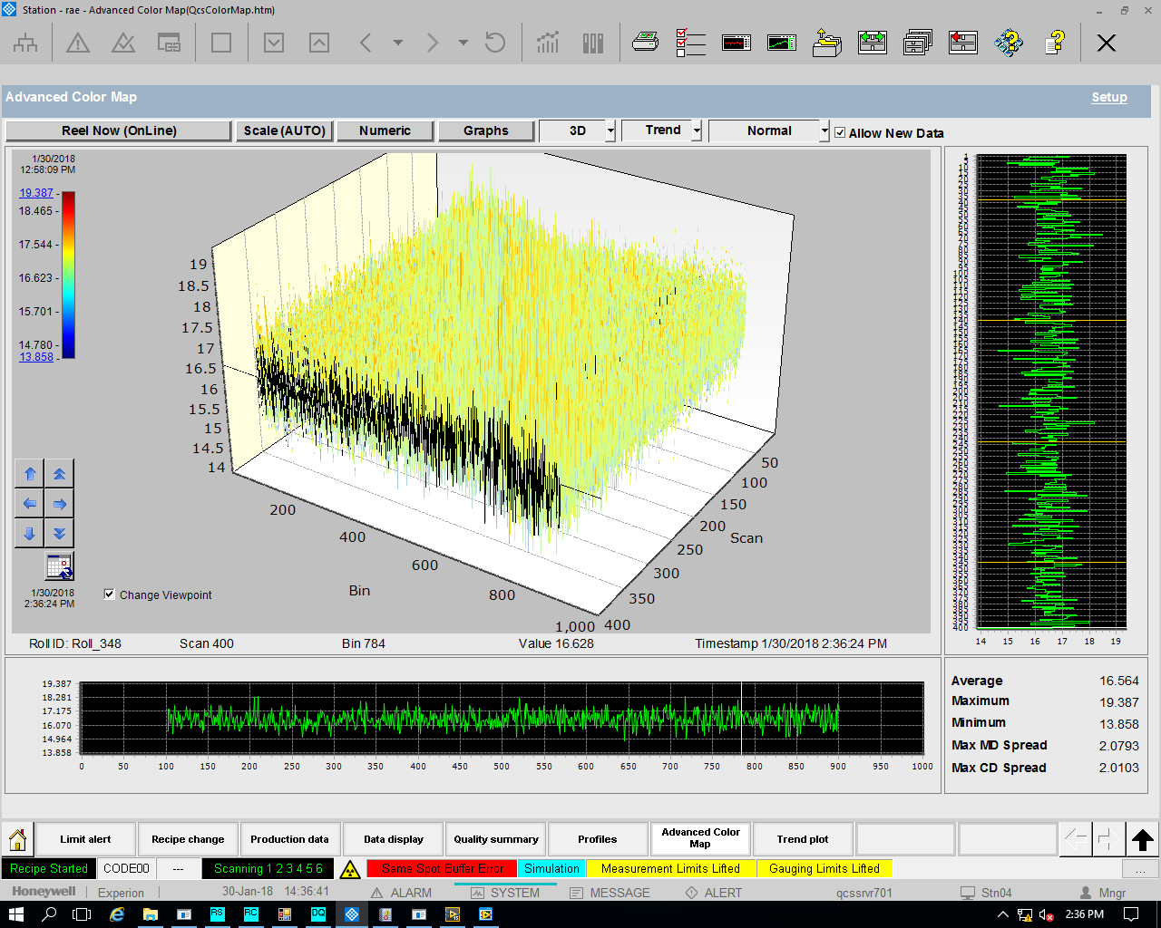
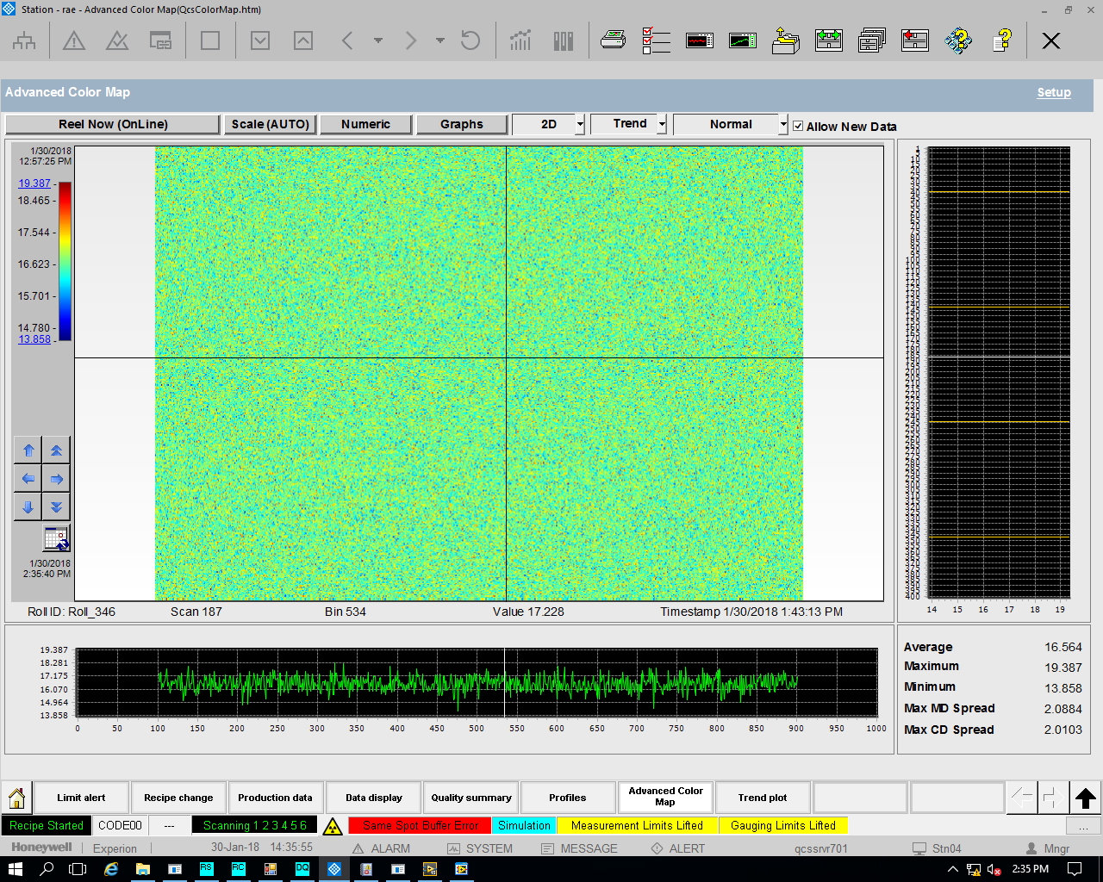
Historical Data Analysis: Color Map
Enhanced to display up to 400 Scans Data at a time
Enhanced to display up to 400 Scans Data at a time

Slide 41
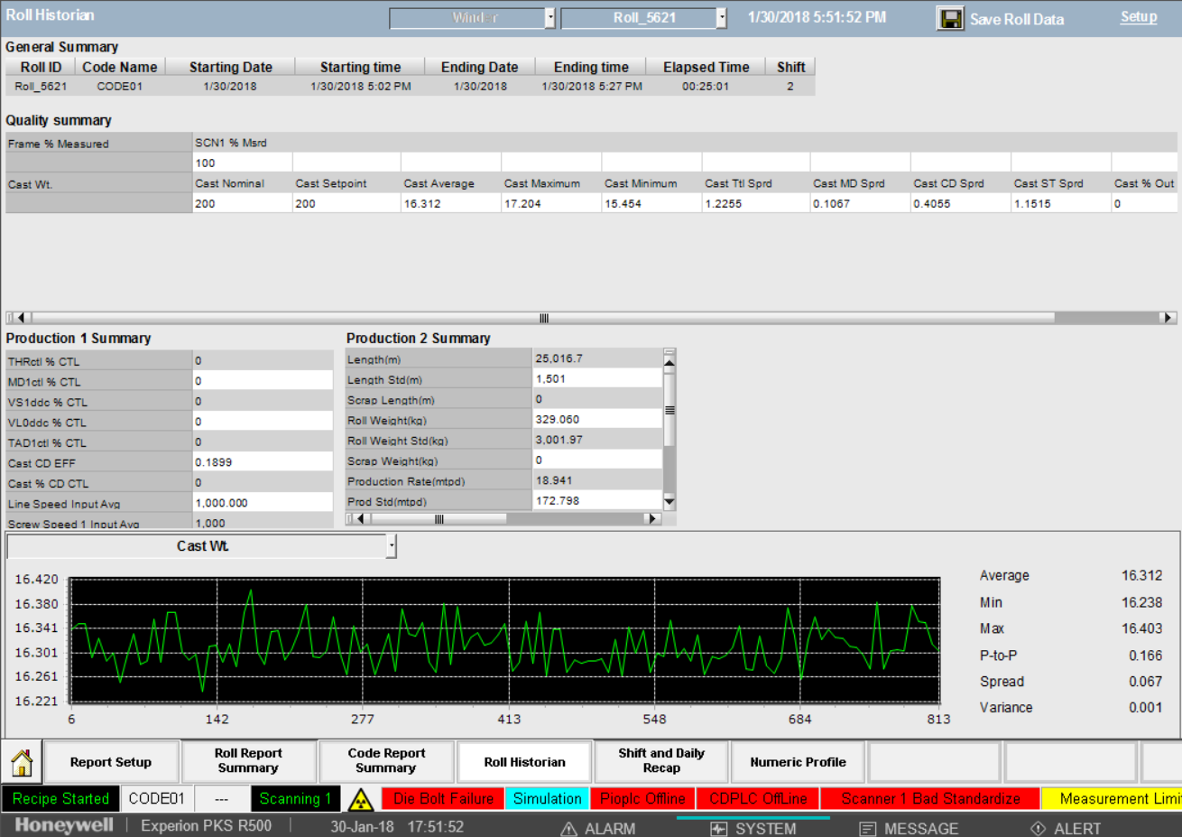
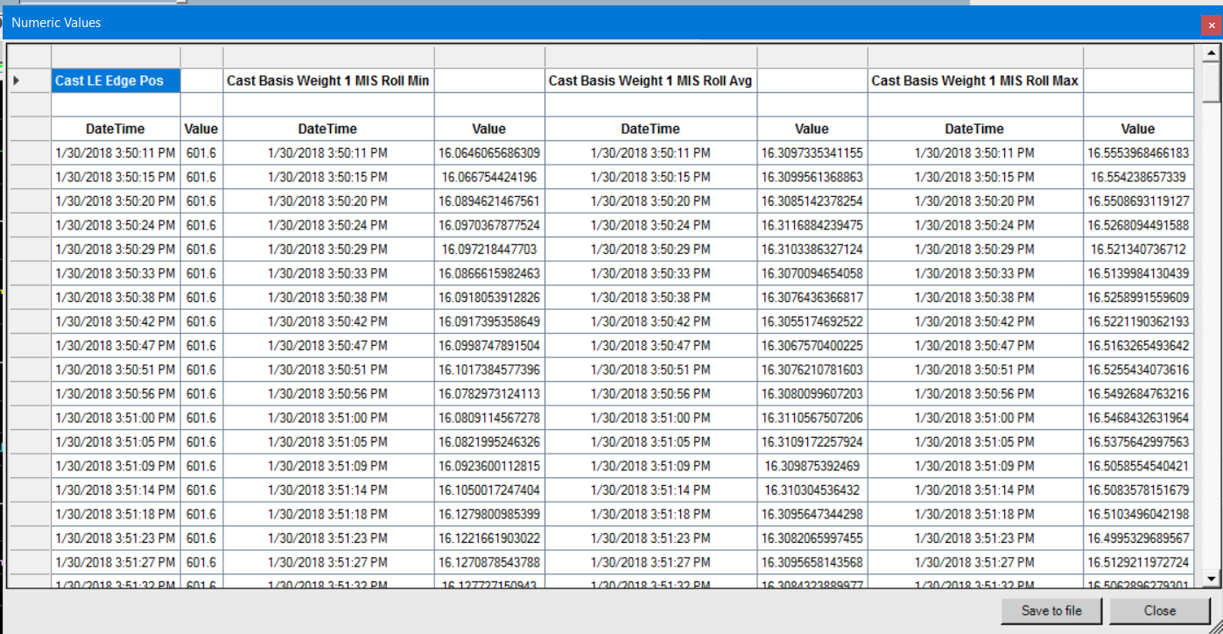
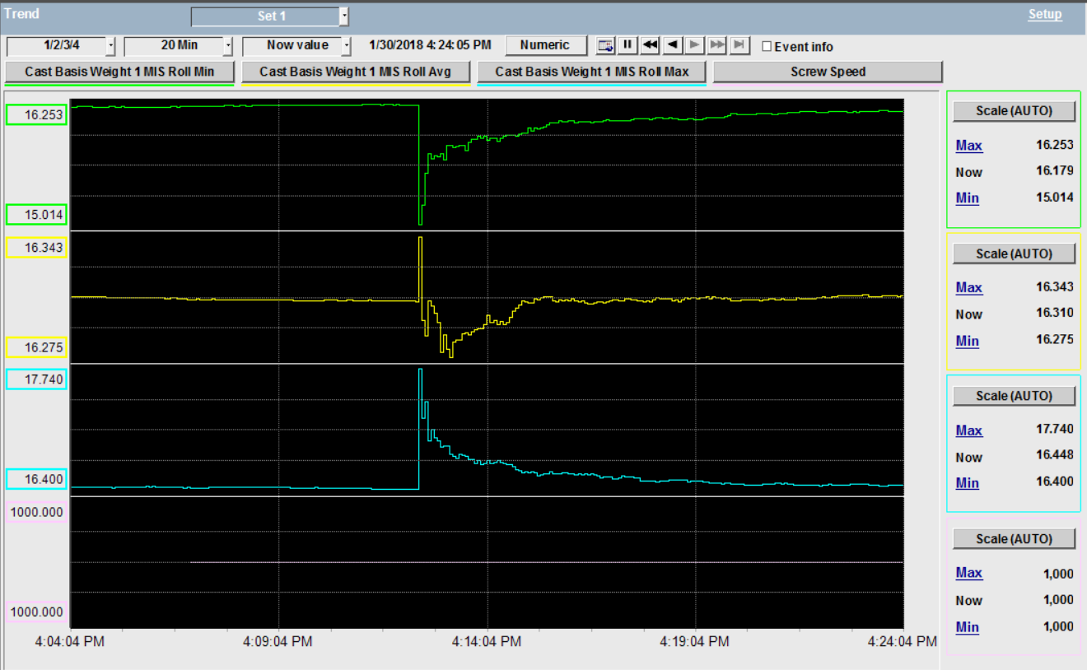
Integrated Displays: Trend, MIS, Export Data
Trend Control will show directly the historical data up to last one year.
In MIS one can select one year old Roll for viewing the report.
Export the tag data for offline analysis.

Slide 42
MD Controls
Steam Pressure
Thick Stock
TiO₂ Flow
Clay Flow
Speed
Dry Weight
0
Reel
Moisture
0
0
Ash
0
0
Opacity
0
Notes:
Updated 2014.04.07by Antti Paavola.

Slide 43
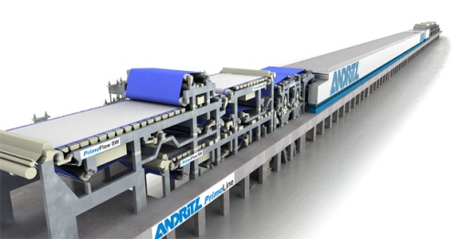
Typical Pulp Dryer machine QCS MD Control
MAJOR CONTROL LOOPS SHOWN
5947 CO-ORDINATED SPEED
CONTROL
SP
5940 REEL Dry
WEIGHT
5961 DRYSTOCK
CONTROL
SP
5943 DRYER
SHUTDOWN
CONTROL
SP
5946 JET/WIRE
CONTROL
5941 De-Coupled
MOISTURE
SP
SP
SP
SP
STOCK
Loop
TOTAL HEAD
Loop
SPEED
Loop
SP
Steam Loop
SteamLoop
Scanner
Weight
Moisture
Dry Weight

Slide 44
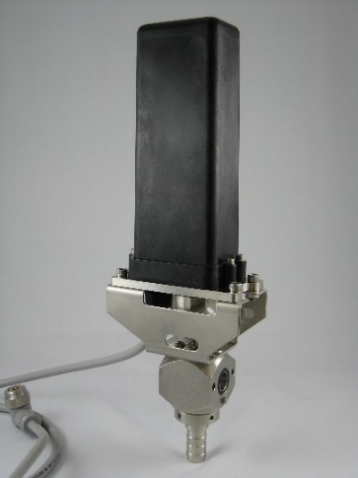
Slice Lip/Dilution Control ProFlow II
Notes:
Updated 2014.04.07by Antti Paavola.

Slide 45
What is ProFlow?
A complete dilution profiling actuator solution from Honeywell
Suitable for use with all makes of dilution headboxes
  Compatible with all rotary distributors and linear dilution headers
  Solutions for rotary or linear valve applications
  Mountings available to customer-supplied valves
  Packaged Honeywell solutions can include valves for total supply
Optimum profiles and profitable results assured with Honeywell profile optimizers including Performance CDMultivariable Control

Slide 46
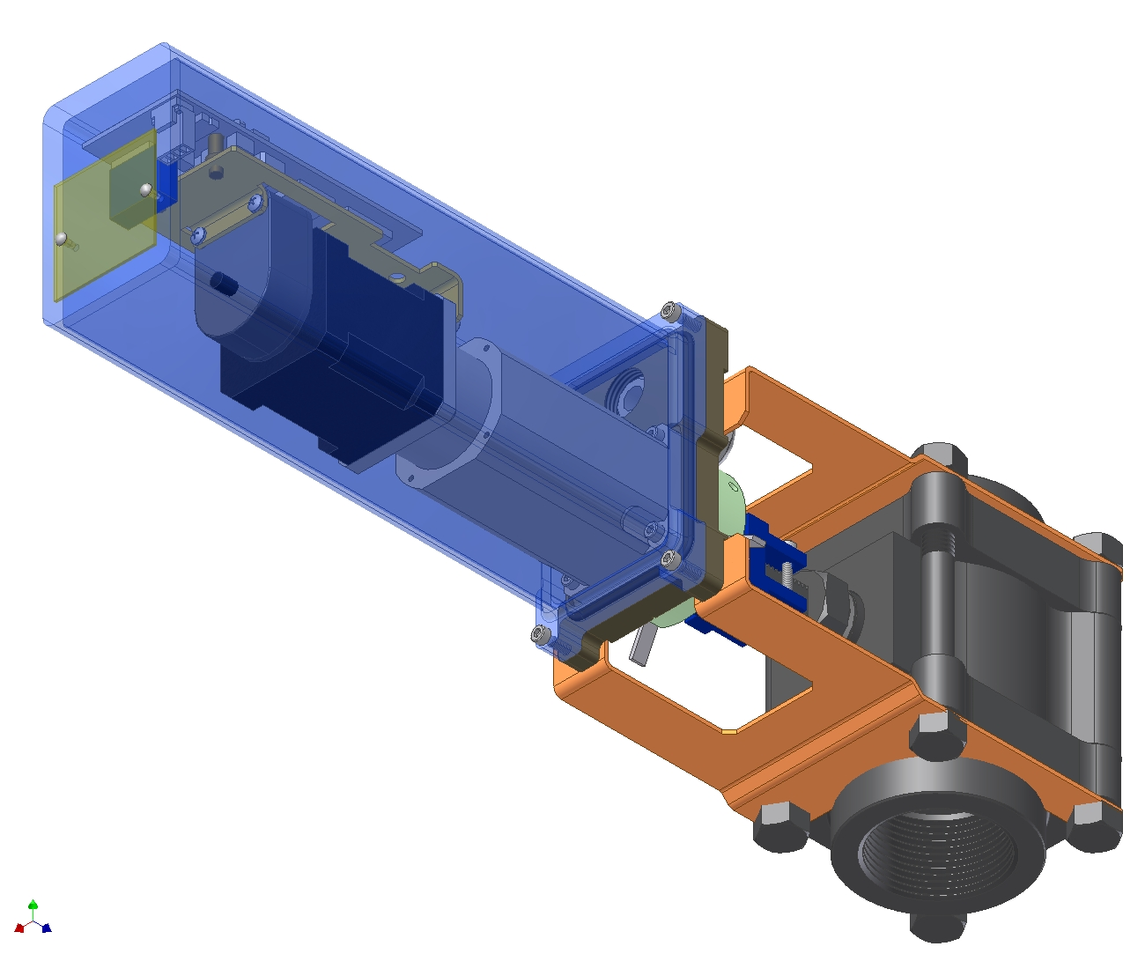
New ProFlow Design
One per Actuator Internal CDConnect Module
Removable Stainless Steel Housing
One Disconnectable Network Drop Cable with ‘Mini’ Connector (not shown)
Planetary Gear
Fixed Internal Mechanical Stops (not shown)
Optical Encoder
DC Stepper Motor
Designed for 20 Nm output torque, optional upgrade within same housing to 30 Nm at additional cost
Position Indicator on Output Shaft
Standard Rotational Valve (up to 1.5”)

Slide 47
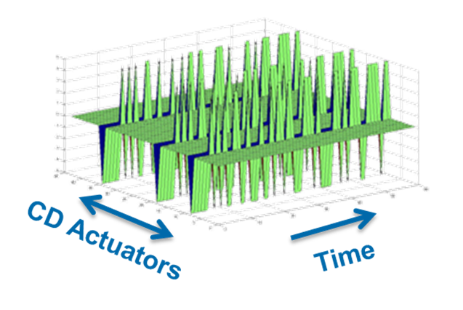
Adaptive Alignment
Notes:
Updated 2014.04.07by Antti Paavola.

Slide 48
Adaptive Alignement Features
After commissioning CD control performances are continuously monitored to detect any changes in actuator’s alignment
If a reduction in control performance is detected the actuator alignment is checked in the background while the CD controls continue to operate as normal.
Alignment parameters can be deployed automatically, or only with the Operator approval

Slide 49
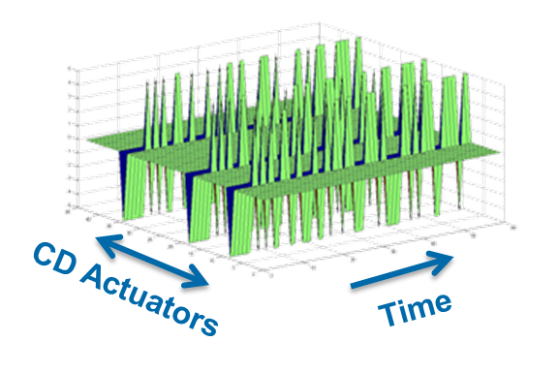
Identification
Executes an intelligent, closed loop, Pseudo-Random Binary Sequence (PRBS) perturbation which adapts to process conditions.
The magnitude, location, and duration
of the PRBS are determined automatically
based on the process dynamics,
CD actuator setpoints and constraints.
  Induces less CD variation than a
  traditional bump test.
If the resulting process model is rated as “Good” the new alignment is deployed. Otherwise, the PRBS is redesigned and repeated

Slide 50
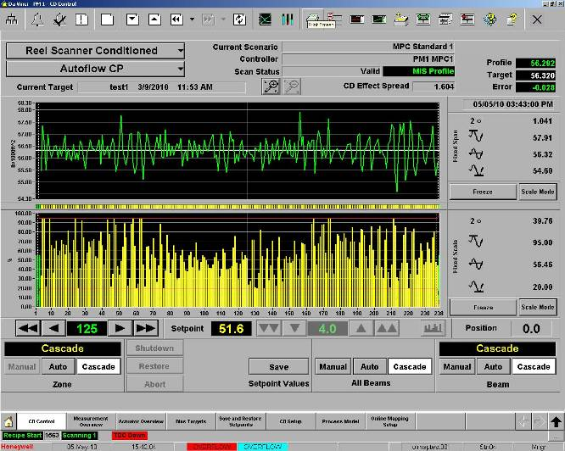
Picketing due to Misalignment

Slide 51
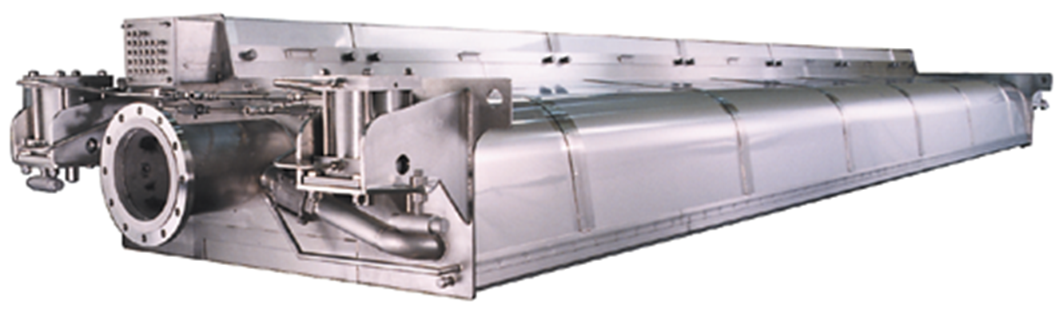
Devronizer Steambox
Notes:
Updated 2014.04.07by Antti Paavola.

Slide 52




Steambox and Hot Pressing Theory
One kilogram of condensing steam will release 2257 kJ of energy and heat 100 kg of water by 5.6ºC
Heat reduces limitations to water removal to accomplish
  Dewatering by hot pressing
  CD moisture profiling
Each 10ºC (18ºF) increase in web temperature increases sheet dryness into the dryers by 1% yielding
  5% speed up or…
  5% dryer load reduction
Profiling systems introduce a temperature profile into the web in the cross direction (CD)
To be effective, temperature profile must get to a press nip(s) OR water removing vacuum boxes
At the same nip pressure, more water is removed from hot areas than from cold areas due to lower water viscosity and surface tension
30C (54F) bump response by Devronizer measured after the press!!

Slide 53


Devronizer Operation
All steam applied is controlled by the XP10 for maximum profiling range
  Profiling steam is fully separated from zone to zone
Actuator inserts completely into steam header
  Reduced cross section enables location in tighter press sections than other steamboxes
  Prevents condensation of steam within actuator
Formed cross section ensures stronger, lighter beam with minimal beam deflection
Designed to stay Clean
Optimum steam delivery, close to the sheet
  Narrow and precise profiling response
  Prevents boundary layer turbulence to mix the profiling steam
The patented screen plates are custom designed to distribute steam evenly at the optimum, application-matched velocity and are engineered to prevent fibers from entering the Devronizer
Flush face
  Limits boundary air
  Limits fiber collection
  Easy to clean
Dynamic
Steam Curtain
Notes:
Vanhat kuvat. Muuta. Vain yksi stage

Slide 54



Devronizer Features
Flush-mounted, patented removable screen plates
  Designed to stay clean
  Mirror finish option available effectively preventing dirt buildup
  Alternate materials of construction available (AL 904L, 254-SMO, AL-6XN) for extreme environments
Adjustable edge deckles
  Installed as standard on all Devronizers
  Adjustable while machine is running
Advanced condensate removal system guarantees drip-free operation with properly conditioned steam
  Condensate removal is provided for all
  internal chambers
  Internally-heated anti-drip edges prevent external condensate dripping
  Steam heated evacuation ducts available as an option where there is risk of condensation on other equipment
Various retraction options available
Notes:
Number 4 mirror finishing.

Slide 55



XP10 Actuator – Ultimate Reliability
Requires no maintenance
  Designed to last the life of the Devronizer
  No elastomers or internal seals
  Completely welded assembly
Sealed to atmosphere
  Impossible to leak or drip from internal condensation
Frictionless Design
  Negligible hysteresis for improved profile control
  Increased flow range
  High resolution
Maintenance Free
Corrosion Resistant
Free of Electronics
Free of Elastomers
Frictionless Motion
ROBUST AND RELIABLE
Backed by a 15-Year Warranty
Notes:
Add XP10/2

Slide 56







Devronizer System With Intelligent IDP Control
Air Signal 6-30 PSI (30-200 kPA)
IDP Control Cabinet
CDWeb Manager
Supervisory Protocols:
Ethernet: OPC, Modbus TPC, ODX
Serial: Modbus RTU, SCL
CDWeb
Explorer &
IDP Scout (optional)
Link to QCS
Ethernet
Power/CDWeb Network LON
Outputs control pressure for up to 8 profiling actuators
Fast response reacts immediately to set point changes
Control resolution <0.5%
IDP2 module recognizes leaks and compensates intelligently:
  assign higher priority to a zone, minimizing the effects of small leaks
  generate diagnostic alarms for easier maintenance planning
Controlled Steam Supply (Flexible Steam Hose)
Instrument Air 60 PSI
(400 kPA)
Steam Control Unit,SCU (Optional)
IDP2 Modules

Slide 57
Devronizer Benefits
Value
Quality and Efficiency
Increase production 5-15% if dryer limited
Reduce fiber consumption
Increase reel moisture targets
Reduced steam usage in dryer section
Increase machine efficiency
Less sheet breaks, less rejects
Increased felt life
30–80% reduction in CD moisture variation
Improved sheet consolidation and strength
Reduced dryer picking
Improved sheet smoothness
Reduced sheet stresses and tension caused by uneven drying
Improved caliper profiles and reel build
Improved runnability
Improve downstream operations
  Calendering, coating, winding, converting and printing
More than 1800 Devronizers delivered covering all grades and all applications
ROI typically less than 6 months!

Slide 58
Q&A
Any Questions?
End of Session
Notes:
Multiple Teams
DCS Vendor, PLC Vendor, EPC, Customer
Extensive co-ordination
Data exchange, System setups, Testing, Troubleshooting
Higher Risk
Schedule risk , Rework, Low Reliability
Inconsistent operator interface
Higher training expenses
Few Teams
One DCS & PLC Vendor, Customer
Less co-ordination
Few teams, Access to system knowledge, Faster system setup, testing and troubleshooting
Low Risk
Reduced elements to manage, Single point of responsibility
Consistent operator interface
Lower Training Expenses

